Slide 1
I Think This is the Beginning of a Beautiful Friendship - On the Rust Programming Language and Secure Software Development in the Industry
Tiago Espinha Gasiba
T CST SEL-DE
Siemens AG
Munich, Germany
email: tiago.gasiba@siemens.com
Sathwik Amburi
T CST SEL-DE
Siemens AG
Technical University of Munich
Munich, Germany
email: sathwik.amburi@{siemens.com, tum.de}
CYBER 2023 : The Eighth International Conference on Cyber-Technologies and Cyber-Systems
Presented by:
Rabib Jahin Ibn Momin (0424052024) Md Zarzees Uddin Shah Chowdhury (0424052042)

Slide 2

Introduction
This paper examines the impact of Rust on secure software development, focusing on its adoption in critical domains like the Linux kernel and Android. Rust addresses vulnerabilities in C, C++, and Java through its emphasis on memory safety and concurrency, reducing risks like null pointer dereferences and data races.

Slide 3


What is Rust?
Rust is a systems programming language focused on three goals : safety, speed and concurrency.

Slide 4

As a programming language …
fn main() {
println!(“Hello, world!”);
}
Rust is a system programming language with some extraordinary features .
Minimal runtime requirement (eg. No GC/Dynamic Type/…)
More control (over memory allocation/destruction/…)
No Data Races.
No dangling references.

Slide 5

More than that…
C/C++
Haskell/Python/Java
more control,
less safety
Rust
less control,
more safety

Slide 6
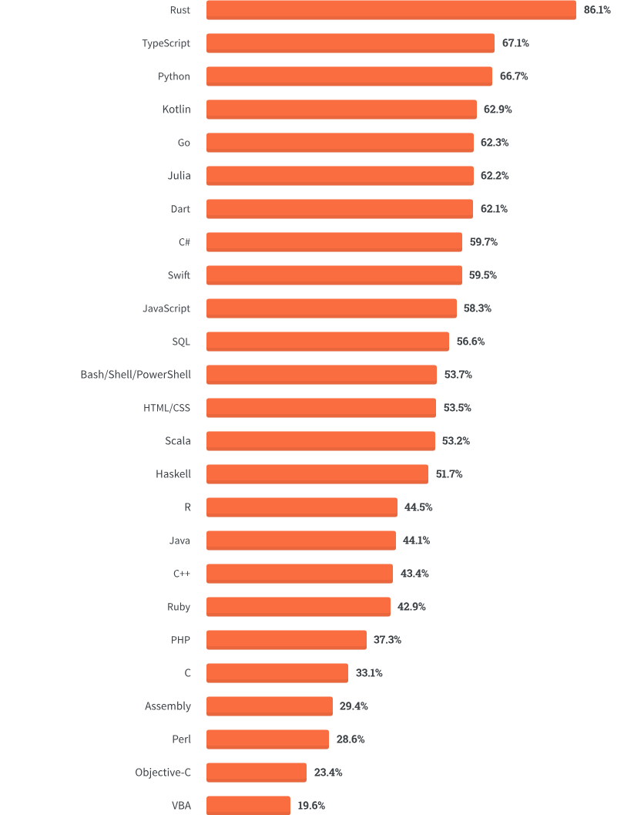
Developer Survey
Most Loved Languages in 2020 Ref: link

Slide 7
Key Contributions
A systematic analysis of Rust's security model compared to C, C++, and Java.
Insights from industry experts on secure Rust programming.
Evaluation of Rust’s compliance with security standards like CWE, OWASP, and SANS.
Evaluation of vulnerabilities in Rust's ecosystem and mitigation strategies.
Examination of the role of unsafe code in Rust and its impact on software security.

Slide 8
Related Work
Rust’s Security Model:
Sible et al. analyzed Rust’s memory and concurrency safety features, emphasizing its robust protections but highlighting limitations such as susceptibility to memory leaks.
Wassermann et al. explored Rust's security vulnerabilities, noting that misaligned design assumptions can lead to risks.

Slide 9
Related Work
Unsafe Code and Memory Safety
Qin et al. studied unsafe code usage in Rust, revealing that most memory safety bugs involve unsafe blocks.
Security Standards and Guidelines:
Various standards, such as IEC 62.443 and CWE, provide frameworks for secure software development. Rust’s safety features align with these standards in many respects but require additional developer effort to meet comprehensive security requirements.

Slide 10
Related Work
Security Documentation and Tools:
Platforms like RustSec and Static Application Security Testing (SAST) tools support developers by identifying vulnerabilities in Rust projects. However, tools for comprehensive security analysis are less mature compared to those for Java and C++.
Ref: https://analysis-tools.dev/tag/rust

Slide 11


Methodology
01
02
03
04
Literature Exploration
Interviews with Security Experts
Mapping to CWE/SANS, OWASP, and 19 Deadly Sins
Analysis with Rust/SAST Tools

Slide 12





Categorization of Protection Level
Rare & Difficult (RD)
Rare & Difficult(RD)
Safeguarded (SG)
Unprotected (UP)

Slide 13
Definitions
Rare and Difficult (RD): Vulnerabilities that are either extremely rare or very difficult to exploit in the language because of its inherent design or features
Safeguarded (SG): These vulnerabilities are partially protected by the language's features or ecosystem, but additional care or tools are required to ensure full safety.
Unprotected (UP): These vulnerabilities are not inherently addressed by the language or ecosystem. The language lacks built-in mechanisms to prevent these issues

Slide 14
EXAMPLE

Slide 15
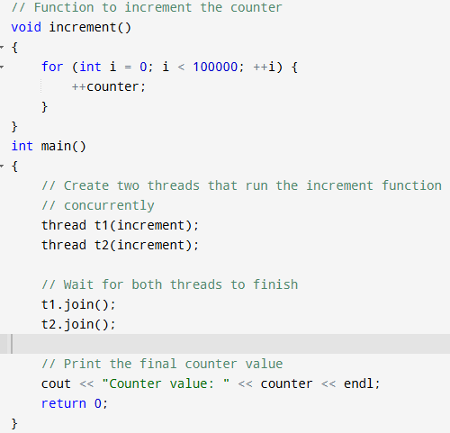
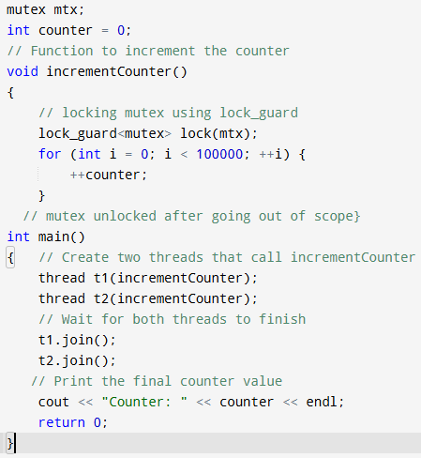


C++ case

Slide 16
C++ case
Unprotected
WHY?
Because the language does not inherently provide mechanisms to prevent them.

Slide 17
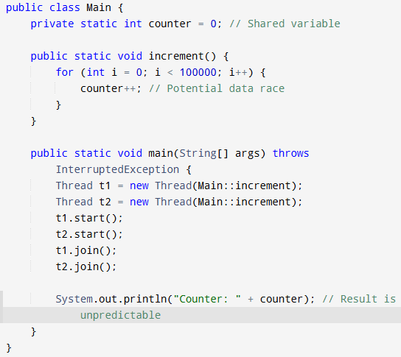
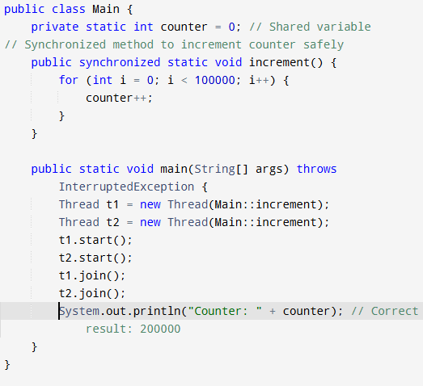


Java case..

Slide 18
Java Case
Safeguarded(SG)
WHY?
Because it provides built-in mechanisms to help prevent them. However, it relies on developers to use these features appropriately

Slide 19
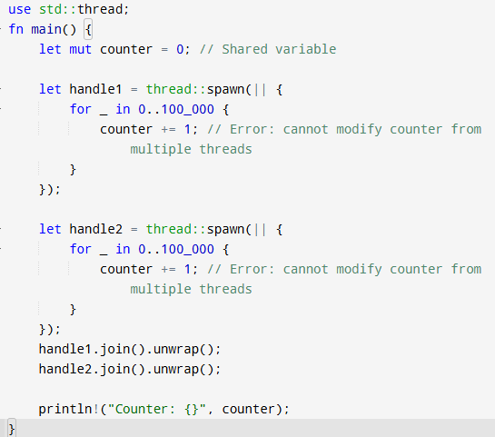
Rust case
Without locking
Compilation Error
Rare & Difficult

Slide 20
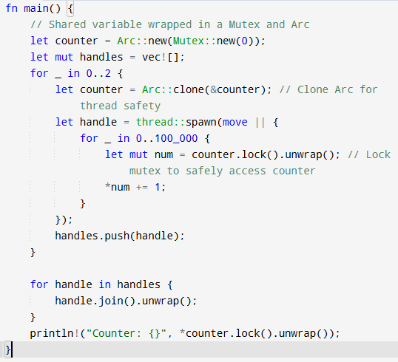

Rust Case

Slide 21
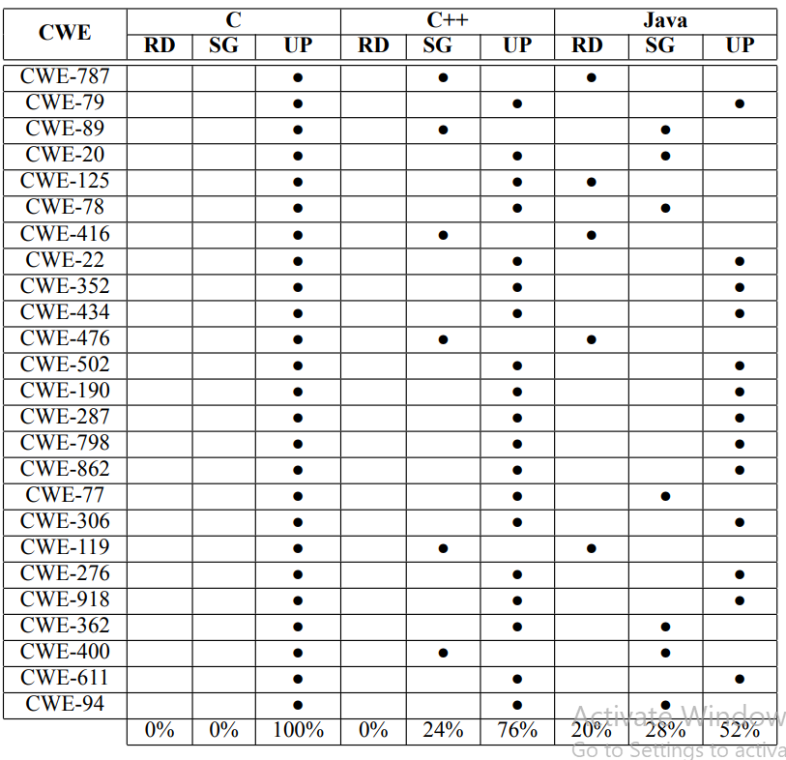
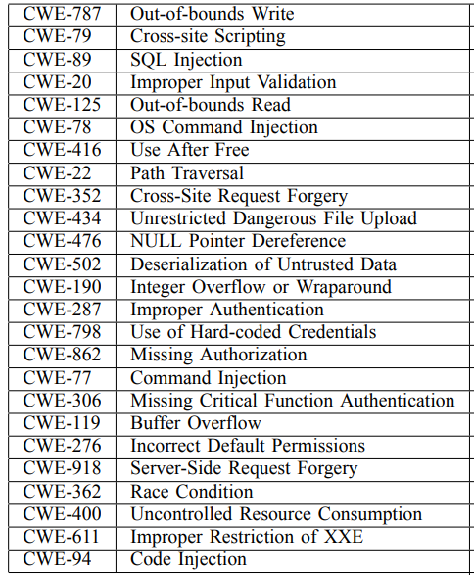



https://www.sans.org/top25-software-errors/

Slide 22
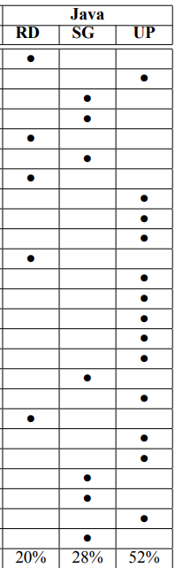
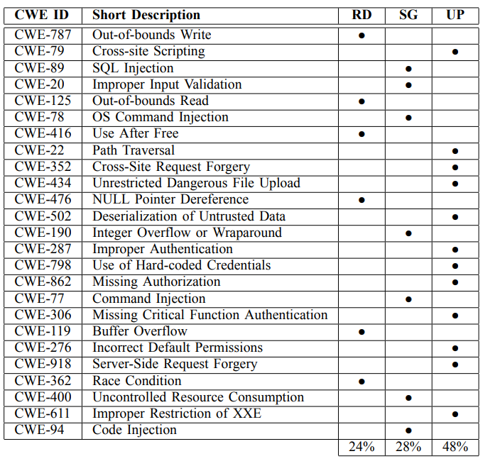

RUST

Slide 23
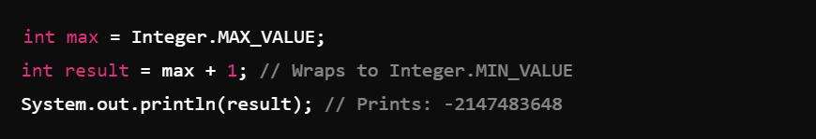
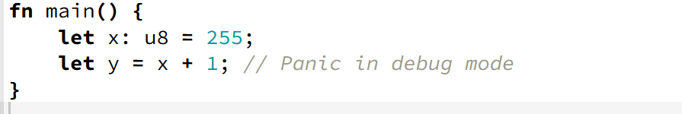
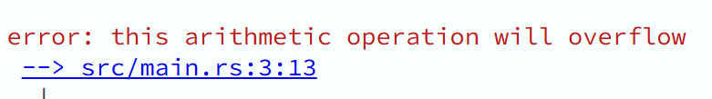
In Java
In Rust

Slide 24
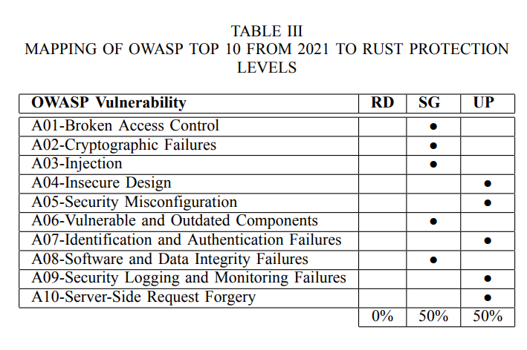

Open Web Application
Security Project

Slide 25
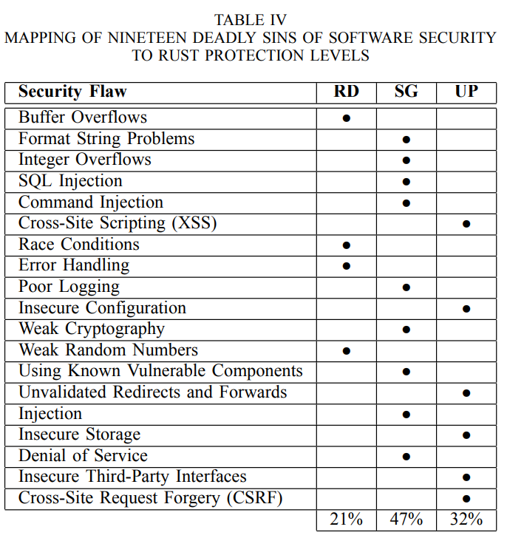
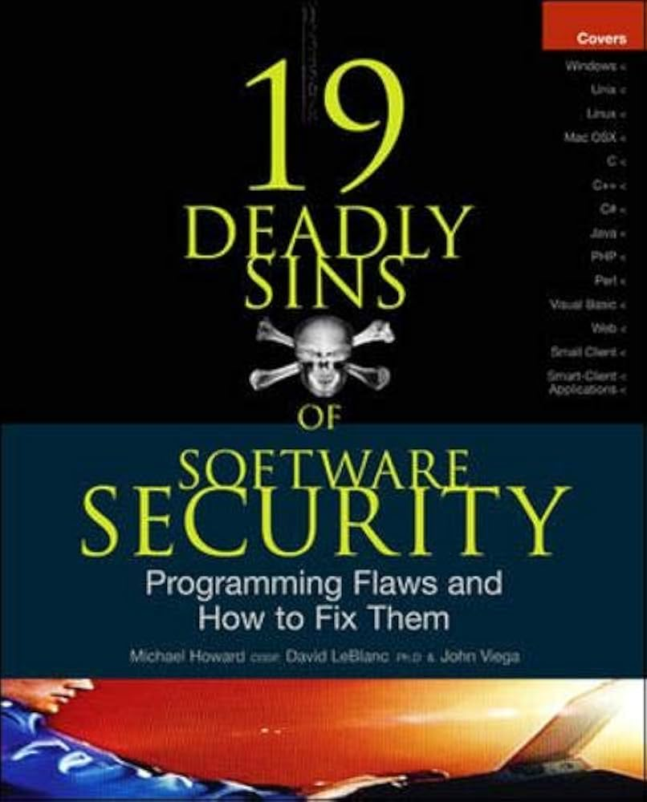

Slide 26

Critical Analysis
Strengths:
Timeliness and Relevance:
The paper addresses Rust, a rising programming language known for its focus on memory safety and concurrency, which is crucial given the increasing importance of secure software development.
The inclusion of Rust in major projects like the Linux kernel and its adoption by Google for Android emphasizes the study's relevance.
Comprehensive Methodology:
A multi-faceted approach combining literature reviews, expert interviews, and vulnerability analysis frameworks (CWE/SANS, OWASP, 19 Deadly Sins) ensures diverse perspectives on Rust's security features.

Slide 27
Critical Analysis (Strengths)
Balanced Viewpoint:
While Rust is highlighted as an improvement over traditional languages like C, C++, and Java, the paper acknowledges that vulnerabilities can still exist
The classification of vulnerabilities into Rare and Difficult (RD), Safeguarded (SG), and Unprotected (UP) provides a nuanced view of Rust's protection levels.
Impact on Academia and Industry:
The discussion about Rust's relative immaturity and the lack of robust tools and skilled developers is crucial for its adoption in critical industries.

Slide 28
Weakness
Limited Depth in Novel Vulnerability Analysis:
The study primarily focuses on existing standards and vulnerabilities without deeply investigating novel or unique challenges specific to Rust.
Interview Scope:
Only five industry experts and two students participated in interviews, which may not adequately represent the broader perspectives required for a robust analysis.
The informal nature of student interviews reduces the rigor of findings related to Rust’s usability and practical adoption.

Slide 29
Weakness
Lack of Quantitative Validation:
The paper lacks large-scale empirical data, such as vulnerability frequency in real-world Rust projects compared to other languages, to substantiate its findings.
Overemphasis on Known Frameworks:
Heavy reliance on existing standards (e.g., CWE, OWASP) may overshadow other important dimensions of security

Slide 30
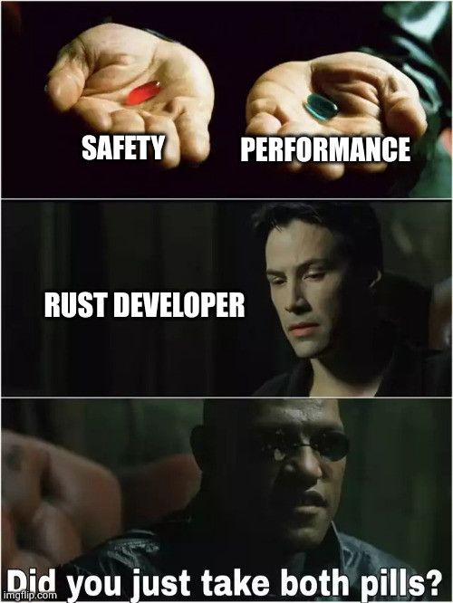
QnA

Slide 31
fn main() {
let a = 42;
let b;
b = a;
println!("{}",a);
}
fn main() {
let a = String::from("Hello");
let b;
let c;
b = &a;
c = &a;
println!("{}",a);
println!("{}",b);
println!("{}",c);
}
fn main() {
let mut a = String::from("Hello");
let b;
let c;
b = &mut a;
c = &mut a;
println!("{}",a);
println!("{}",b);
println!("{}",c);
}
fn main() {
let a = String::from("Hello");
let b;
b = a;
println!("{}",a);
}
fn main() {
let mut a = String::from("Hello");
let b;
let c;
b = &mut a as *mut String;
c = &mut a as *mut String;
println!("{}",a);
unsafe{
println!("{}",*b);
println!("{}",*c);
}
}

